Slide 1


Slide 2

Motives and Risks in the Acceptance of Augmented Reality in Young E-Consumers’ Decisions: Cross-Countries Qualitative Research
Małgorzata BARTOSIK-PURGAT, Tomasz GRZEGORCZYK, Monika GUZEK, Wiktoria RAKOWSKA, Patricia BALBOA, Ryne A. JOHNSON
Poznań University of Economics and Business
MAIN OBJECTIVE: The paper's main objective is to answer RQs about the significance of factors affecting the acceptance of AR technologies by young e-commerce consumers in different countries.
RQ1: What motives and risks influence young consumers' acceptance of AR in e-commerce?
RQ1a: Do hedonic motivation, effort, and performance expectancy motivate young
consumers' acceptance of AR in e-commerce?
RQ1b: Do perceived AR-driven purchase and perceived privacy risks impact young consumers' acceptance of AR in e-commerce?
RQ2: Are there any differences in the degree of AR acceptance in e-commerce among young consumers from diverse cultures?
THEORETICAL BACKGROUND: the consumer acceptance theories (TAM, UTAUT, UTAUT2)
This study was partly funded by the National Science Centre (Poland), grant no. 2022/47/B/HS4/00448 and by the Minister of Science under the “Regional Initiative for Excellence” programme.

Slide 3
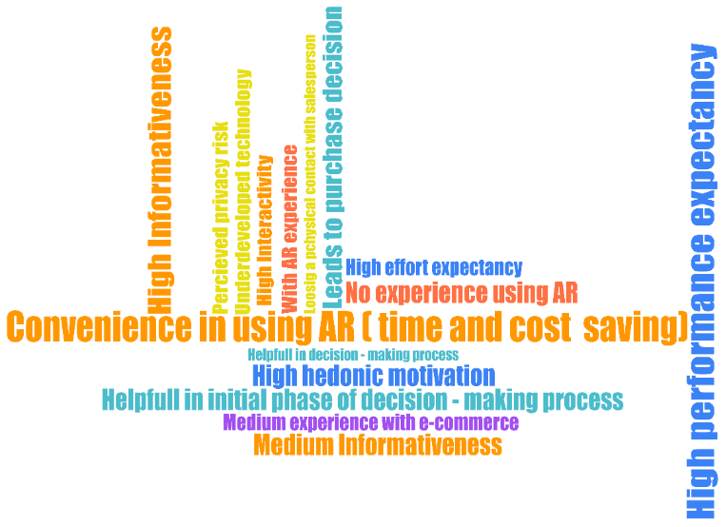

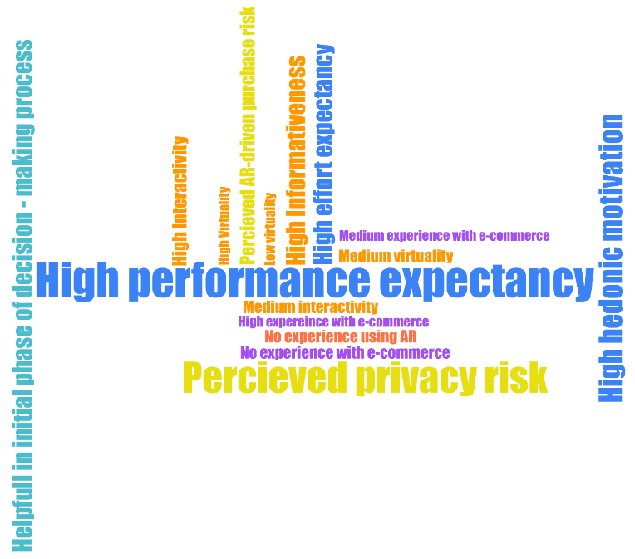
RESEARCH METHODS:
The narrative literature review based on Emerald and Science Direct Databases
Primary research method: Focus Group Interviews (FGIs) – six focus groups (two interviews in each country) with a short experiment (February-April 2024), qualitative analysis with the use of MAXQDA
Primary research sample: Poland, South Korea and the United States, consumers belong to Gen Z (born between 1996 and 2015)
Product category: glasses
This study was partly funded by the National Science Centre (Poland), grant no. 2022/47/B/HS4/00448 and
by the Minister of Science under the “Regional Initiative for
Excellence” programme.
South Korea
Poland
The United States

Slide 4
RESULTS:
Hedonic motivation
Americans - AR in e-commerce is fun, “pretty cool,” etc.
Koreans - AR in e-commerce could be fun, but with friends and at the beginning of use.
Poles - there is less enthusiasm; it may be more fun for younger and older people than the participants` age.
Effort expectancy
All groups indicated that AR technology is easy to use and intuitive and does not require much effort to cope with.
Performance expectancy
Almost in all groups - convenience and comfort, time-saving, providing a large amount of information about the product.
Risks
Almost in all groups - fear of disappointment with the purchased product, i.e., that it will be different in reality than it looked online, and the risk of sharing and storing personal data.
This study was partly funded by the National Science Centre (Poland), grant no. 2022/47/B/HS4/00448 and by the Minister of Science under the “Regional Initiative for Excellence” programme.

Slide 5
WHAT IS NEW in OUR RESEARCH?
In the group of motivators, information performance can be added as a factor influencing AR use in e-commerce.
In the group of risks, there are health concerns that sitting at home in isolation and buying online with AR may negatively affect people's mental health. Nevertheless, problems are identified about young people's lack of willingness to socialize, ability to communicate, and capacity to form relationships.
This study was partly funded by the National Science Centre (Poland), grant no. 2022/47/B/HS4/00448 and by the Minister of Science under the “Regional Initiative for Excellence” programme.

