Slide 1


Slide 2

Bibliometric and critical review of Augmented Reality in E-commerce: Cross-cultural perspective
Małgorzata Bartosik – Purgat; Tomasz Grzegorczyk; Wiktoria Rakowska
Department of International Management; Poznan University of Economics and Business
PURPOSE
This study aims to map the current research landscape on AR use in e-commerce in relation to cultural dependences and propose future research directions through a critical literature review and bibliometric analysis.
METHODOLOGY
1.We used VOSviewer for a bibliometric analysis by mapping bibliographic coupling and keyword co-occurrence patterns from the Scopus database.
2. We conducted a critical literature review focused on cultural variations in AR acceptance, using specific keywords related to cross-cultural analysis.
This study was partly funded by the National Science Centre (Poland), grant no. 2022/47/B/HS4/00448 and by the Minister of Science under the “Regional Initiative for Excellence” Programme.

Slide 3

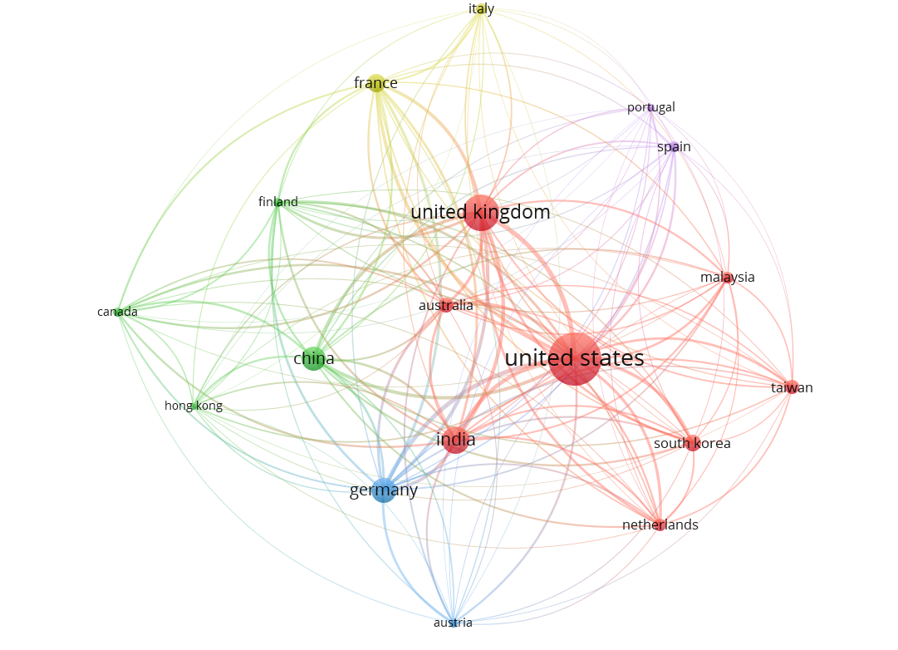
CONCLUSIONS
We identified key research themes such as AR marketing, technology adoption, and consumer behavior, noting a gap in intercultural studies.
Our analysis revealed distinct clusters among organizations, journals, countries, and keywords.
While AR technology is increasingly employed in e-commerce, cultural factors remain underexplored, yet they significantly impact AR acceptance.
Cultural traits such as collectivism, power distance, and uncertainty avoidance notably influence consumers' perceptions and acceptance of AR in e-commerce.
Perceived usefulness, ease of use, enjoyment, and social influence are also affected by cultural variations.
Figure 6. Bibliographic coupling analysis by country (min. 5 articles)
This study was partly funded by the National Science Centre (Poland), grant no. 2022/47/B/HS4/00448 and by the Minister of Science under the “Regional Initiative for Excellence” Programme.

