Slide 1


Slide 2

Małgorzata Bartosik – Purgat & Wiktoria Rakowska
Department of International Management; Poznań University of Economics and Business
Gender in Acceptance of Augmented Reality in E-commerce – An International Perspective
RESEARCH QUESTIONS
RQ1 Does gender influence the motives of young consumers’ acceptance of AR in e-commerce?
RQ2 Does gender influence the risks of young consumers' acceptance of AR in e-commerce?
PURPOSE
THEORETICAL BACKGROUND
Motives and Risks identified in UTATU2 model
The objective of the article is to answer research questions about the role of gender in the significance of factors (motives and risks) affecting the acceptance of AR technologies by young international E-commerce consumers.
METHODOLOGY
Narrative Literature Review
Six FGIs and coding using MAXQDA software
Young consumers Poland, South Korea and the United States
This study was partly funded by the National Science Centre (Poland), grant no. 2022/47/B/HS4/00448 and by the Minister of Science under the “Regional Initiative for Excellence” Programme.

Slide 3
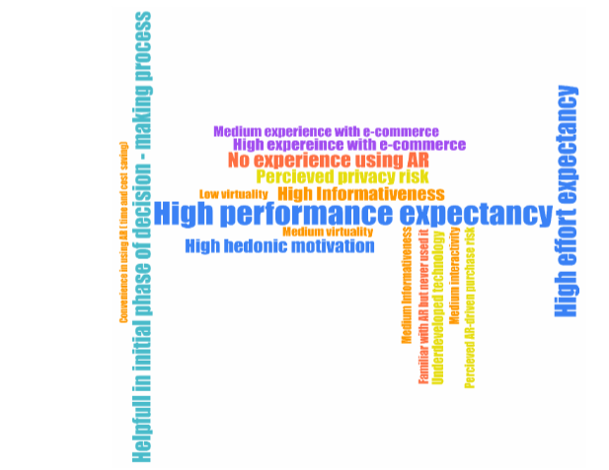
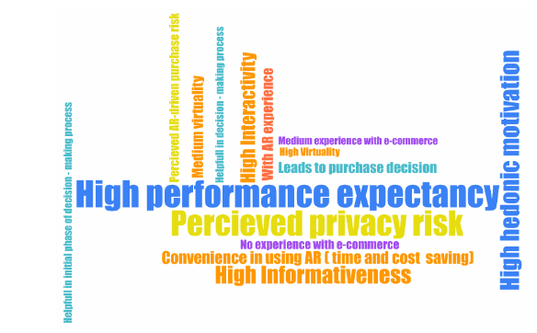
RESULTS
Figure 1. Code Cloud based on Men’s Statements
Source: own elaboration in MAXQDA program
Figure 2. Code Cloud based on Women’s Statements
Source: own elaboration in MAXQDA program
CONCLUSIONS
Regarding the role of gender in impacting the motives and risks connected with consumers' use of AR technology in online shopping decisions, gender differentiates both motivation and risks.
This study was partly funded by the National Science Centre (Poland), grant no. 2022/47/B/HS4/00448 and by the Minister of Science under the “Regional Initiative for Excellence” Programme.

