Slide 1
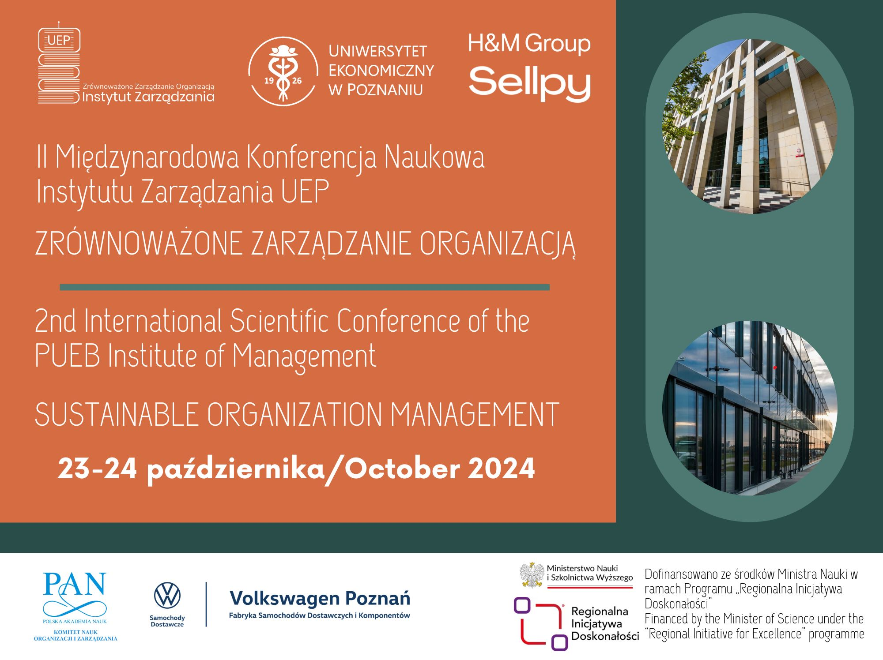

Slide 2

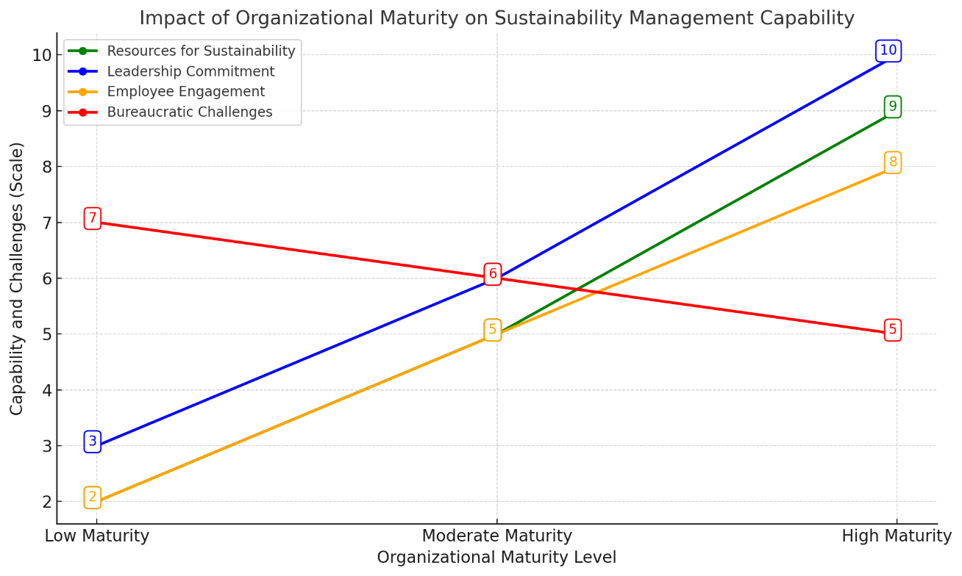
The Impact of Organizational Maturity on Sustainable Managment Capability
Joanna BERNACKA, Indra PONNUSWAMY, Marcin GOŁEMBSKI
Factor | Mature Organizations | Immature Organizations | Comments
Leadership Commitment | Strong leadership driving strategic sustainability goals with embedded ESG and SDG priorities. | Leadership is reactive, often driven by external pressures rather than internal conviction. | Mature organizations benefit from experienced leadership, while immature organizations react to external pressures.
Resource Availability | Ample resources to invest in sustainability programs, innovation, and technology. | Limited capital for sustainability initiatives; prioritizing short-term profitability. | Mature organizations allocate resources better, while immature organizations face financial limitations.
Strategic Alignment | Long-term sustainability vision integrated into core business strategies. | Short-term focus on survival, making it difficult to allocate resources to sustainability goals. | Immature organizations often prioritize immediate financial survival over long-term sustainability strategies.
Employee Engagement | Higher levels of engagement as sustainability is embedded into the organizational culture. | Lacks formal structures necessary for sustained employee engagement. | Employee engagement is often more established in mature organizations due to better governance structures.
Agility and Flexibility | Mature organizations struggle with bureaucratic inertia, hindering rapid changes. | More agile in adapting to sustainability requirements but often lacks strategic depth. | Immature organizations are more adaptable but lack long-term planning seen in mature organizations.
Complexity of Certification | Struggle with the burden of multiple certifications (e.g., ISO 14001, ESG frameworks). | Find certifications challenging due to limited experience and knowledge. | Both types face challenges with certifications, but mature organizations deal with bureaucratic complexity.
Financial Impact of Sustainability | Better positioned to absorb sustainability costs as part of long-term planning. | Faces difficulties in justifying sustainability investments due to budget constraints. | financial burden is a shared concern, but mature organizations are better equipped for long-term financial impacts.
Regulatory and Certification Burden | Overwhelmed by numerous certifications and the fragmented global standards. | struggles with understanding and complying with multiple standards. | The complexity of global standards creates challenges for both, but the burden is heavier for mature organizations
Design/methodology/approach: Participants were purposefully sampled, with most interviewees being auditors or practitioners involved in sustainable management or inspection. The core component of this qualitative study involved 16 individuals, in-depth, semi-structured interviews.

