Slide 1


Slide 2
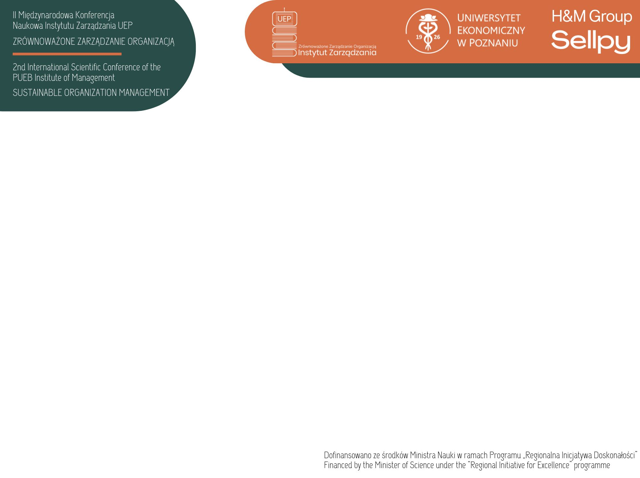
Consumers’ perception of green products
Martyna Fira | Doctoral School, SGH Warsaw School of Economics
WHAT IS A „GREEN PRODUCT”?
RESULTS
Green (eco-friendly, ecological, environmentally friendly) product – a tangible or intangible product that minimises its direct and indirect environmental impact during its whole life-cycle, subject to the present technological and scientific status (Sdrolia, Zarotiadis, 2019)
(mainly packaging- and ingredient-related general attributes)
RESEARCH QUESTIONS
(mainly iconic cues)
RQ1. Which product and packaging attributes make Polish consumer think of a product as green?
RQ2. In which FMCG product categories do Polish consumers expect green products the most and the least?
RESEARCH METHODOLOGY
A CAWI survey conducted among the participants of an Internet panel with the use of a standardized questionnaire, n = 188

