Slide 1


Slide 2

SUSTAINABILITY ASSESSMENT OF EU MEMBER STATES USING THREE-STAGE CLOSED-CYCLE DEA
Przemysław Garsztka
przemyslaw.garsztka@ue.poznan.pl
Poznań University of Economics and Business
Anna Łozowicka
anna.lozowicka@ue.poznan.pl
Poznań University of Economics and Business
Goals
Introduction of the 3-stage closed-cycle DEA (3CCDEA) model for efficiency estimation of DMUs in three interrelated dimensions
Comprehensive assessment of the efficiency of sustainable development policy implementation in 27 European countries and the creation of a single ranking covering all three interrelated dimensions of sustainable development

Slide 3

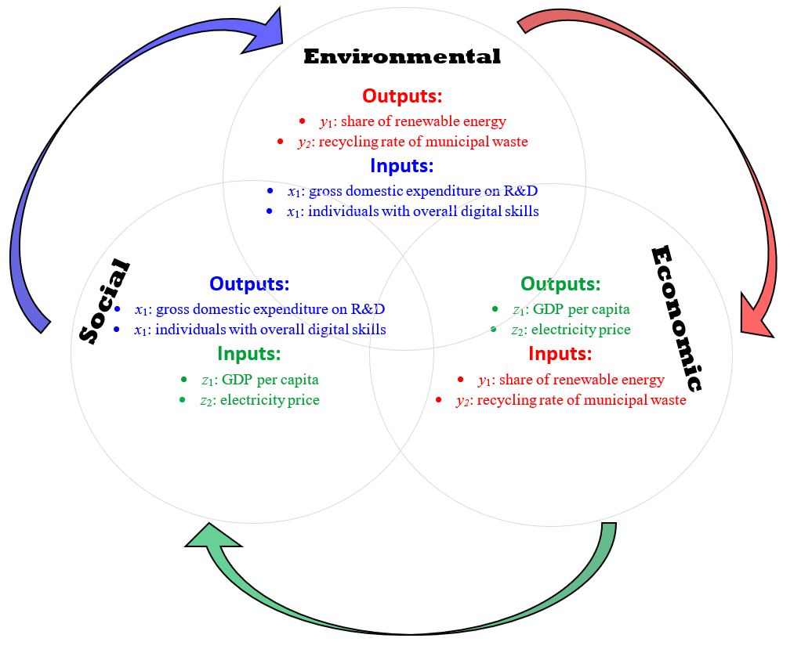
Methods
Using a standard DEA to assess efficiency in the three dimensions of sustainability results in three separate rankings that do not take into account interdependencies between dimensions.
However, it seems possible to construct such a single general ranking using 3CCDEA which is based on network DEA. Product of three separate efficiencies is a proxy of the overall efficiency based on the concept of cycled structure (Fig.1):
Fig.1. Interdependencies between dimensions of sustainable development in three-stage closed-cycle DEA
Source: Own study

Slide 4
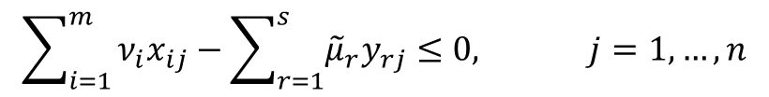
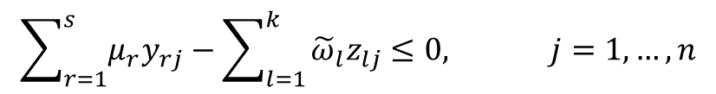
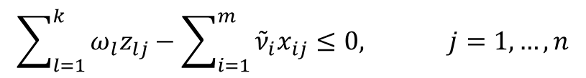
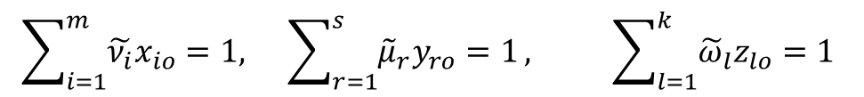
Methods
3-stage closed-cycle DEA (3CCDEA) model which is based on the basic CCR model:
$${\max{ }}_{ }{\frac{\sum_{l=1}^{k}{ω_{l}z_{lo}}}{\sum_{i=1}^{m}{{\tilde{ν}}_{i}x_{io}}}∙\frac{\sum_{r=1}^{s}{μ_{j}y_{jo}}}{\sum_{l=1}^{k}{{\tilde{ω}}_{l}z_{lo}}}∙\frac{\sum_{i=1}^{m}{ν_{i}x_{io}}}{\sum_{r=1}^{s}{{\tilde{μ}}_{r}y_{ro}}}}=e_{o}^{1}∙e_{o}^{2}∙e_{o}^{3}$$
s.t.
$$\sum_{i=1}^{m}{\tilde{ν_{i}}x_{io}=1, } \sum_{r=1}^{s}{{\tilde{μ}}_{r}y_{ro}=1}, \sum_{l=1}^{k}{{\tilde{ω}}_{l}z_{lo}}=1$$
$$\sum_{l=1}^{k}{ω_{l}z_{lj}}−\sum_{i=1}^{m}{{\tilde{ν}}_{i}x_{ij}}≤0, j=1,…,n$$
$$\sum_{r=1}^{s}{μ_{r}y_{rj}}−\sum_{l=1}^{k}{{\tilde{ω}}_{l}z_{lj}}≤0, j=1,…,n$$
$$\sum_{i=1}^{m}{ν_{i}x_{ij}}−\sum_{r=1}^{s}{{\tilde{μ}}_{r}y_{rj}}≤0, j=1,…,n$$
$$μ_{r}, {\tilde{μ}}_{r}≥0, r=1,...,s ν_{i}, {\tilde{ν}}_{i}≥0, i=1,...,m ω_{l},{\tilde{ω}}_{l}≥0, l=1,...,k$$

Slide 5
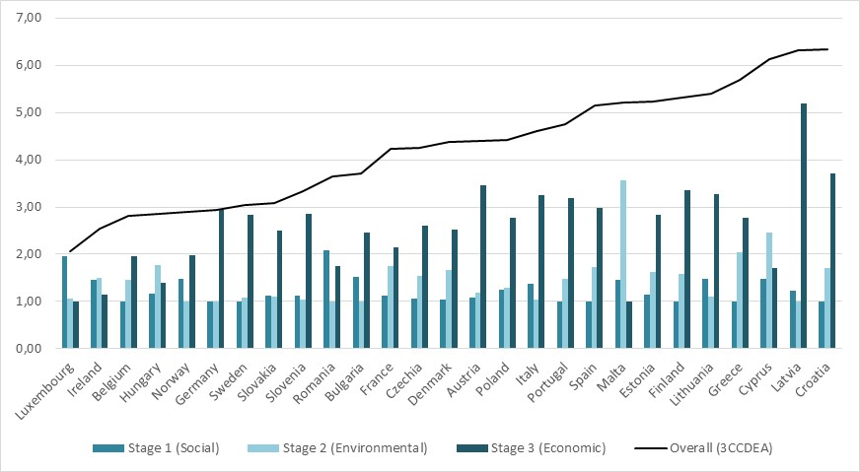
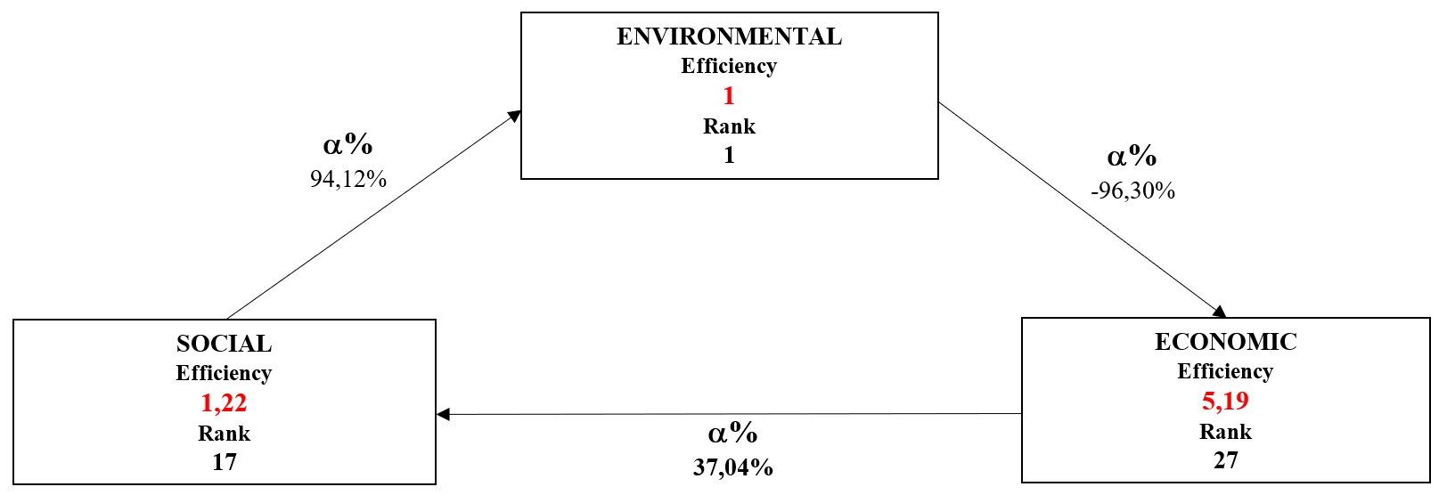
Results
Fig.2. Efficiency scores obtained for 27 European countries using 3CCDEA (results of separate three stages and the overall 3CCDEA ranking)
Fig.3. The change of Latvia's rank between the stages
Source: Own study
Source: Own study

Slide 6
Conclusions
This approach significantly reduces the number of benchmarks to those that actually have better and more sustainable technologies. The benchmark in a given dimension should not be a country that is below the country under study in the overall ranking (i.e., based on the product of the stages' efficiencies).
Noteworthy is the lack of non-punitive recommendations based on a single model – confirming Liang, Cook and Zhu’s (2008) conclusion that you can't improve efficiency in one dimension without potentially worsening efficiency in another dimension.
The product of three efficiencies can only be used for ranking purposes (it has no interpretation).
Liang L., Cook W. D., Zhu J., 2008, DEA models for two-stage processes: Game approach and efficiency decomposition. Naval Research Logistics, 55(7), 643–653.

