Slide 1


Slide 2


Assumptions of the theoretical model of social acceptance of Moblity-as-a-service
ALEKSANDRA GULC, PhD
FACULTY OF ENGINEERING MANAGEMENT
BIALYSTOK UNIVERSITY OF TECHNOLOGY

Slide 3
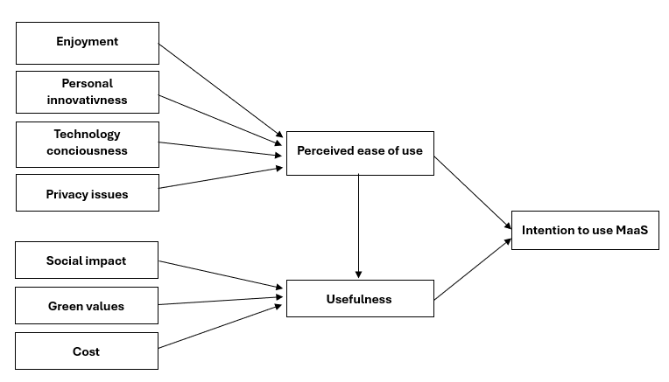
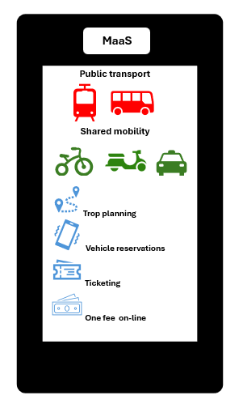
Purpose: presentation of the results of the literature review on technology acceptance models regarding Mobility-as –a service and elaboration of theoretical model
Research method: a literature review of acceptance models for Mobility-as –a service.
Mobility –as –a service
Mobility-as-a-service (MaaS) is a comprehensive, integrated and multimodal mobility service. In practice, it is a platform to manage your travel that allows you to (Koźlak, 2018):
plan a trip using various modes of transportation (public transportation, rail and shared mobility);
book and purchasee a single ticket for an entire trip
on different modes of transportation;
provide up-to-date information for travelers using
multiple modes of transportation;
iintegrate the services in the form of packages that
include specific sets of available transportation services;
customize the offerings to meet individual user needs.
Fig. 1. Graphic of MaaS
Fig. 2. Theoretical model of MaaS acceptance
Conclusions
Integration of transportation services in Polish cities reaches low level (no integration of services, integration of public means of transportation, integration of trip planning and payment of a single service).
No research was found on the social acceptance of MaaS in Polish cities.
There are few studies in the literature on social acceptance of MaaS.
Most of analysed models are based on TAM (Davis, 1985) or UTAUT (Venkatesh et al., 2008) including factors like ease of use, usefulness, intention to use, cost, effort, hedonic motives.
The specificity of MaaS requires adding new factors like privacy issues, enjoyment, personal innovation, technology consciousness, green values.
Literature review of MaaS acceptance models
Source | Factors
Lopez-Carreiro et al., 2024 | individuals’ expectations of the mobility services integrated by MaaS, tech-savviness. privacy issues, need for reliability, control concerns over the network, green values
Stella, 2024 | perceived ease of use, trust, intention to use, perceived privacy concerns, perceived risk, secondary use of personal information, mobility information
Mola et al., 2020 | perceived cost saving, ease of use, usefulness, intention to use
Rey-Moreno et al., 2023 | flexibility, efficiency, integration guarantees, sustainability, safety and protection, social benefits, automation facilitates, connectivity, accessibility, user experience
Alyavina et al., 2020 | car dependence, trust, human element externalities, value, cost
Fioreze et al., 2019 | travel costs, comfort, travel time, environment, flexibility, healthiness
Schikofskya et al., 2020 | perceived ease of use, perceived usefulness, hedonic motives, habit related motives, autonomy, competence, relatedness, behavioral intention to use MaaS
Kriswardhana & Esztergár-Kiss, 2024 | performance expectancy, effort expectancy, social impact, facilitating conditions, perceived risk, technology readiness, environmental consciousness, and variety-seeking lifestyle
This research was funded by National Science Centre, Poland within grant number 2022/45/B/HS4/01414.

