Slide 1
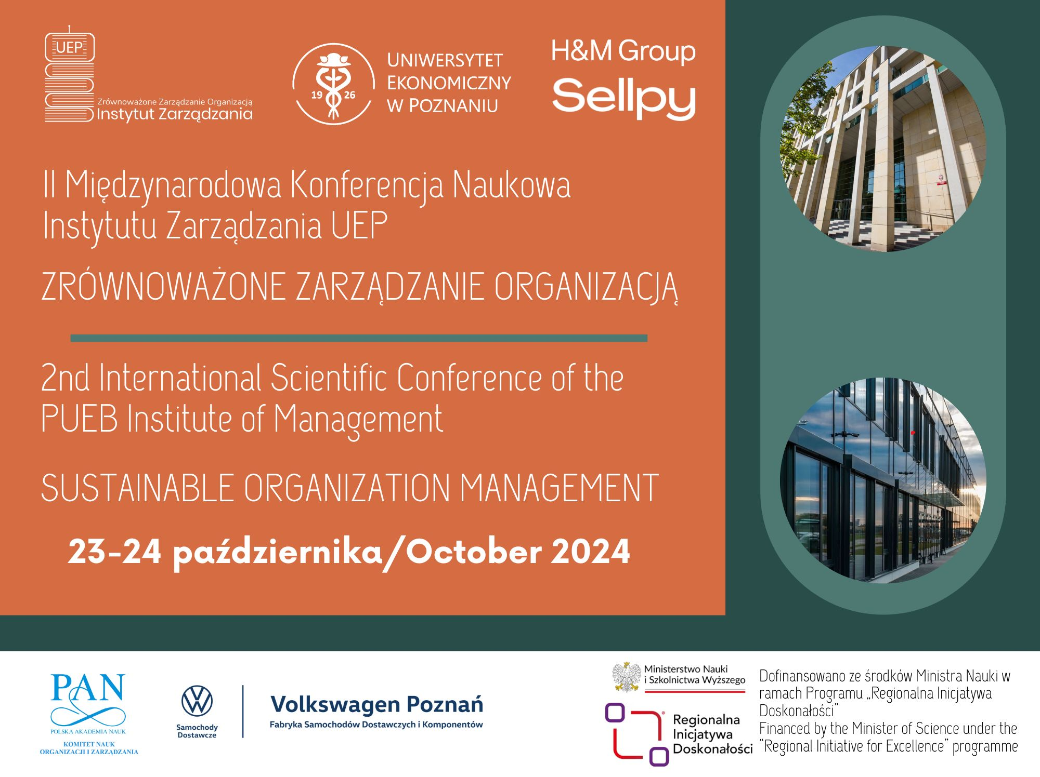

Slide 2

National Science Centre, 2021/41/N/HS4/03698
Transformation of Employee-Driven Innovation (EDI) into Organizational Routine (OR) - preliminary findings
Agnieszka Padzik-Wołos, Akademia Leona Koźmińskiego
Introduction
Organizational challenge: how to sustain EDI initiatives, so that they turn into Organizational Routines?
Research goal: exploration of EDI transformation process, with influencing factors and dynamics (phases).
RQs
RQ1: What are the process phases?
RQ2: Which factors’ categories enable or impede transformation?
RQ3: Which patterns are common across cases?
Key findings
Transformation phases: EDI Creation, EDI Implementation and EDI Solidification into OR
9 groups of influencing factors’ categories
Each case with own combination of categories
Factors’ categories common for all the cases only for EDI Creation and EDI Implementation
Fig.1. Factors’ categories common for all cases
Method
Multiple case study
Case – existing EDI program
Research unit – EDI which transformed into OR
3 cases from different branches (building, food production and bank)
Contribution
Body of knowledge: highlighting internal differentiation and complexity of EDI process
Practical – better EDI management with reference to EDI transformation
 | enablers | impediments
EDI Creation phase | Individual | Corporate culture Human support
EDI implementation phase | Human support Resources | Individual, Resources Communication
Charmaz, K. (2008). Reconstructing grounded theory. The SAGE handbook of social research methods, 461-478.
Feldman, M. S., Pentland, B. T. (2003). Reconceptualizing organizational routines as a source of flexibility and change. Administrative science quarterly, 48(1), 94-118.
Høyrup, S. (2010). Employee-driven innovation and workplace learning: basic concepts, approaches and themes. Transfer: European Review of Labour and Research, 16(2), pp. 143-154

