Slide 1
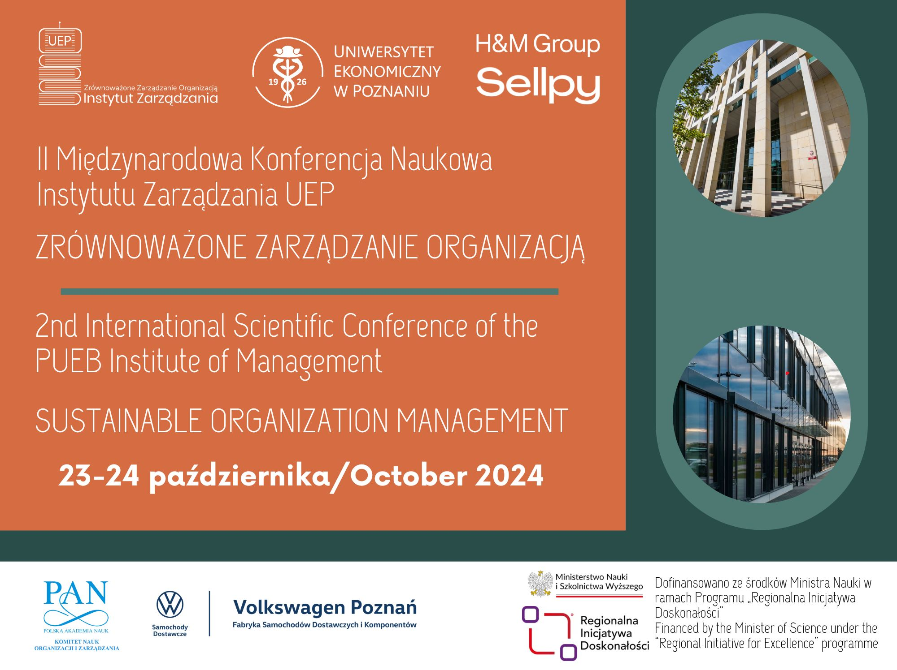

Slide 2
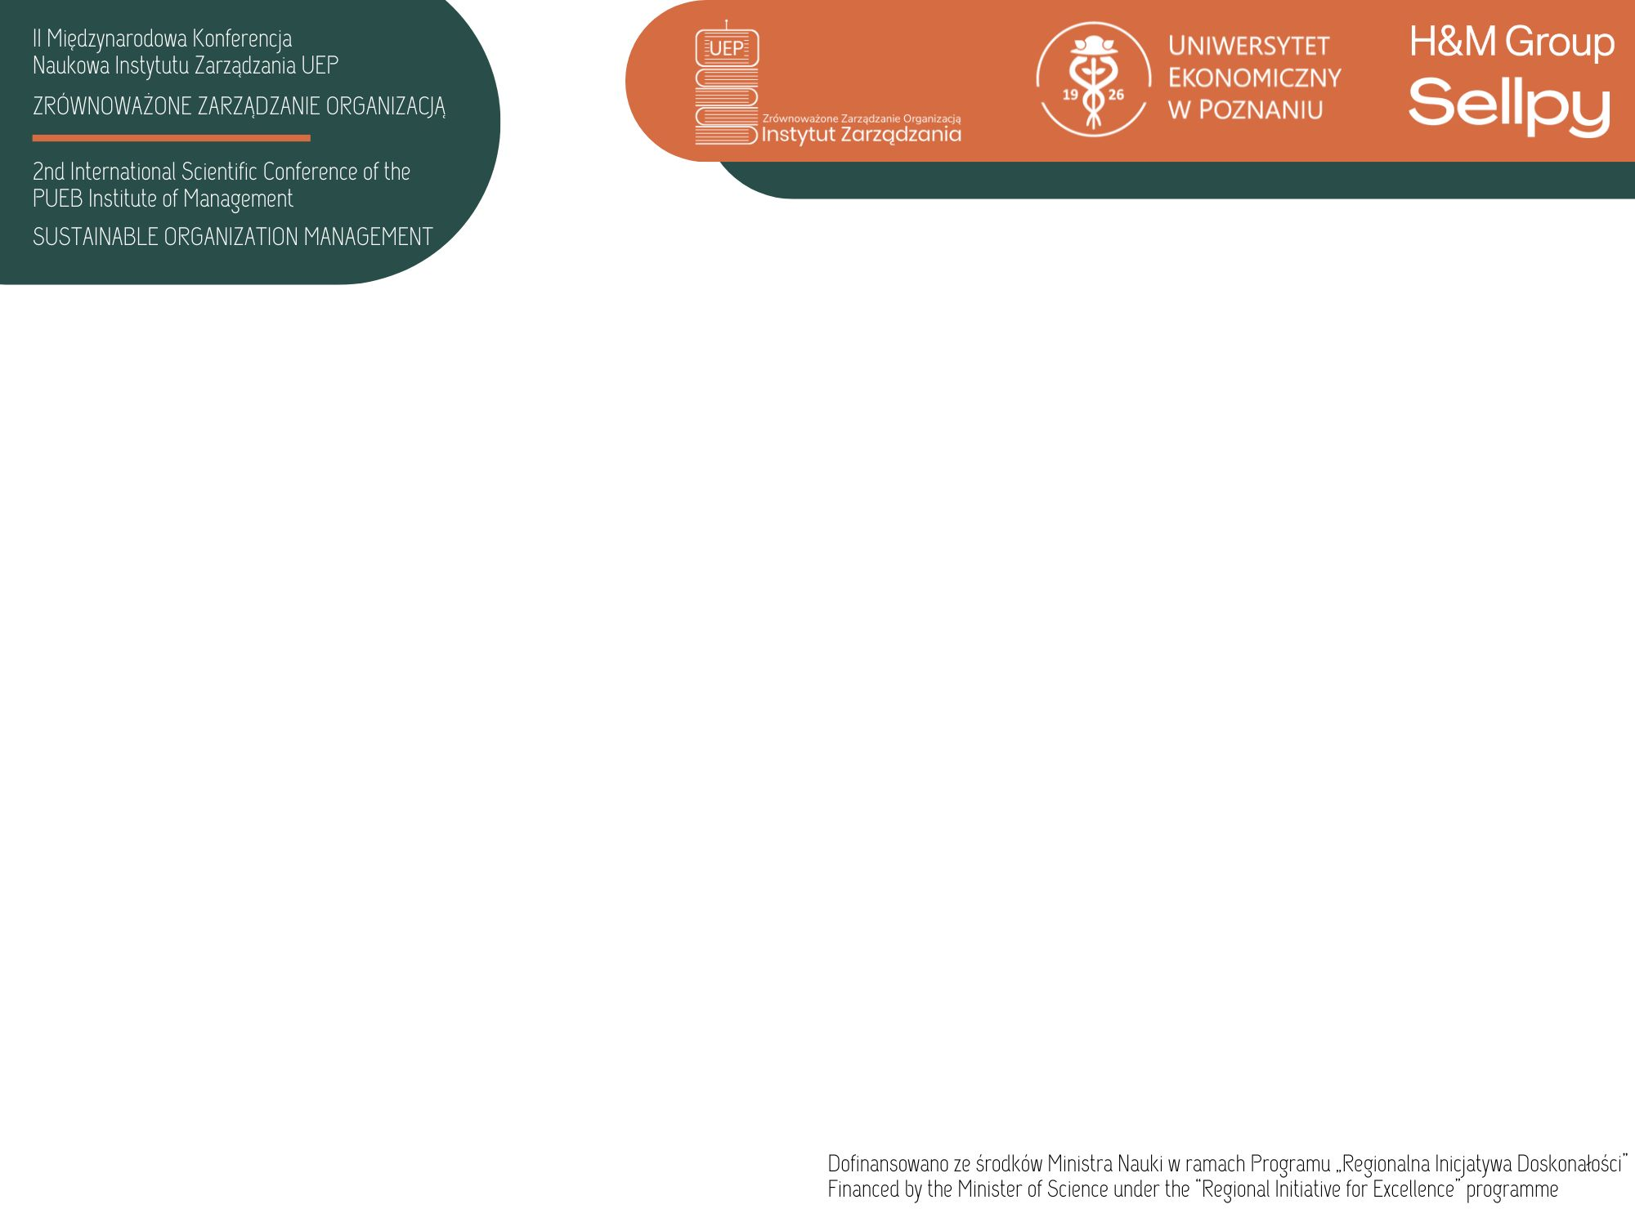
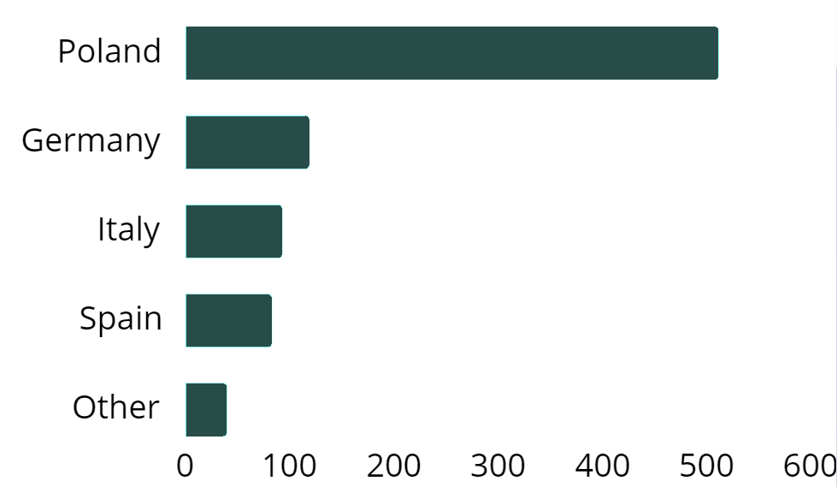
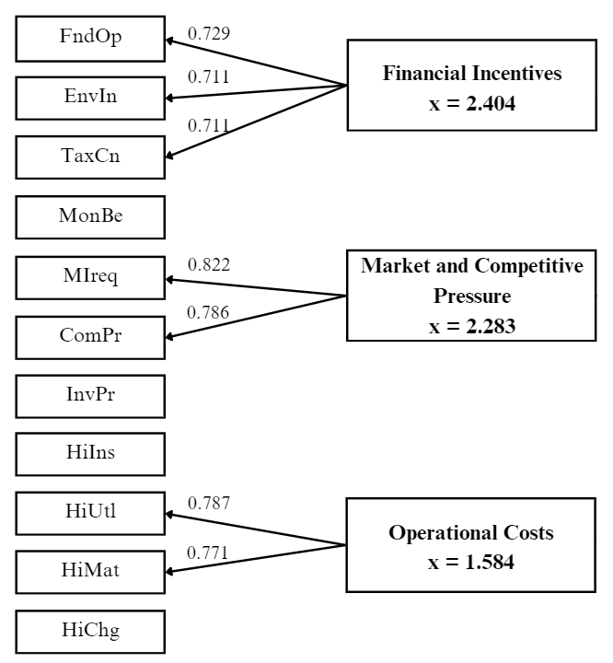
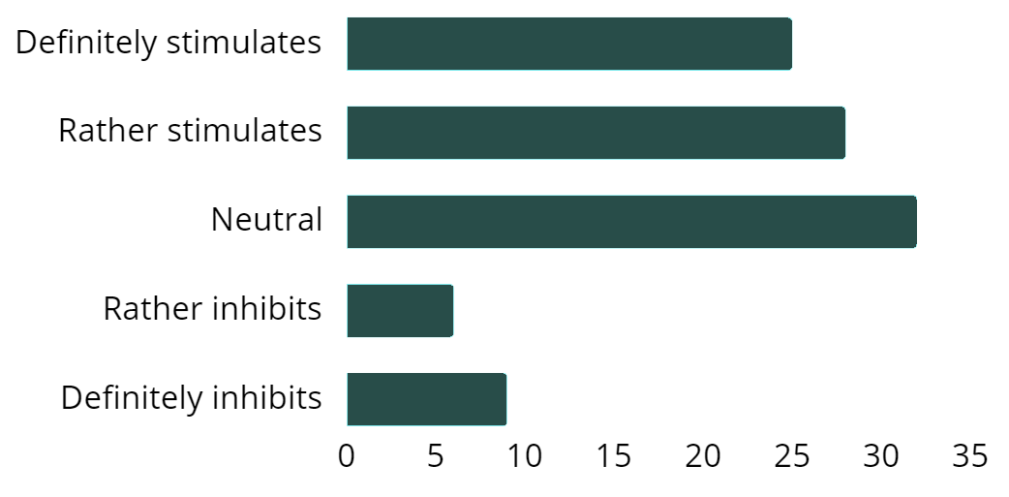
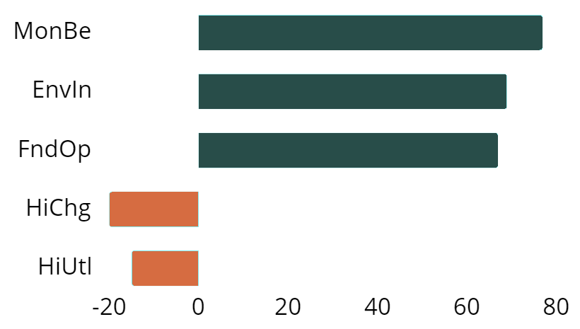
Economic Factors Impacting the Environmental Performance of Organizations
  Economic factors more often stimulate environmental performance rather than inhibit it.
  Financial Incentives and Market Pressures stimulate environmental performance.
  Operational Costs inhibit environmental performance.
Sample n=847
Average
Top stimulants vs.
top inhibitors
This research has been supported by the National Science Centre (Poland) within the framework of project No. ID: 523914 Environmental effectiveness of the organization and its determinants.
Authors: dr inż. Beata Paliwoda, prof. dr hab. inż. Alina Matuszak-Flejszman

