Slide 1


Slide 2

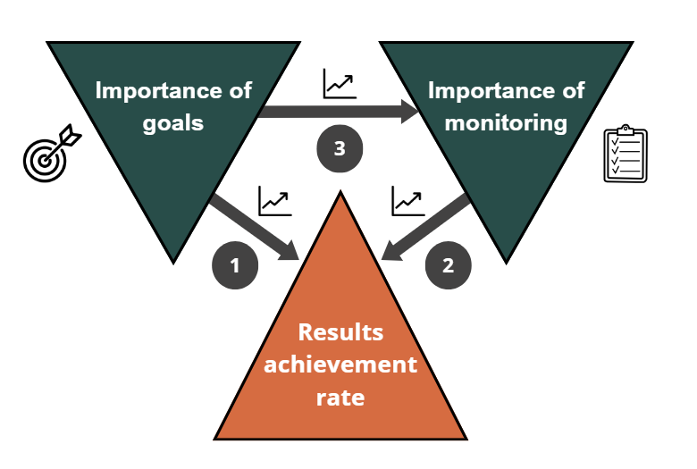
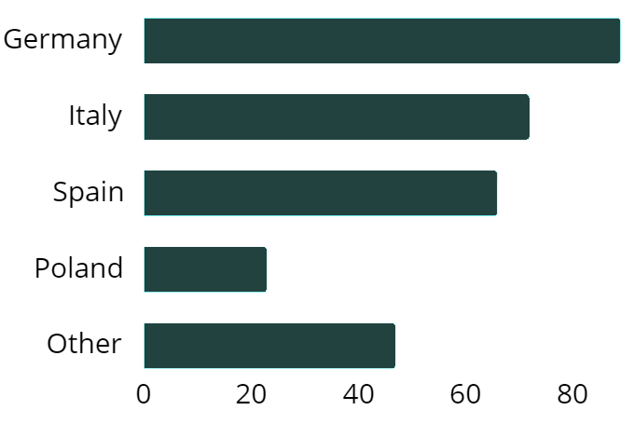
Environmental Goals and Indicators in EU EMAS-Registered Organizations
  The emphasis placed on environmental goals is positively correlated with the outcomes achieved.
  Organizations that prioritize monitoring tend to achieve better results.
  Organisations that prioritize environmental goals also place a strong emphasis on monitoring.
This research has been supported by the National Science Centre (Poland) within the framework of project No. ID: 523914 Environmental effectiveness of the organization and its determinants.
Authors: dr inż. Beata Paliwoda, prof. dr hab. inż. Alina Matuszak-Flejszman
Sample n=297

