Slide 1


Slide 2

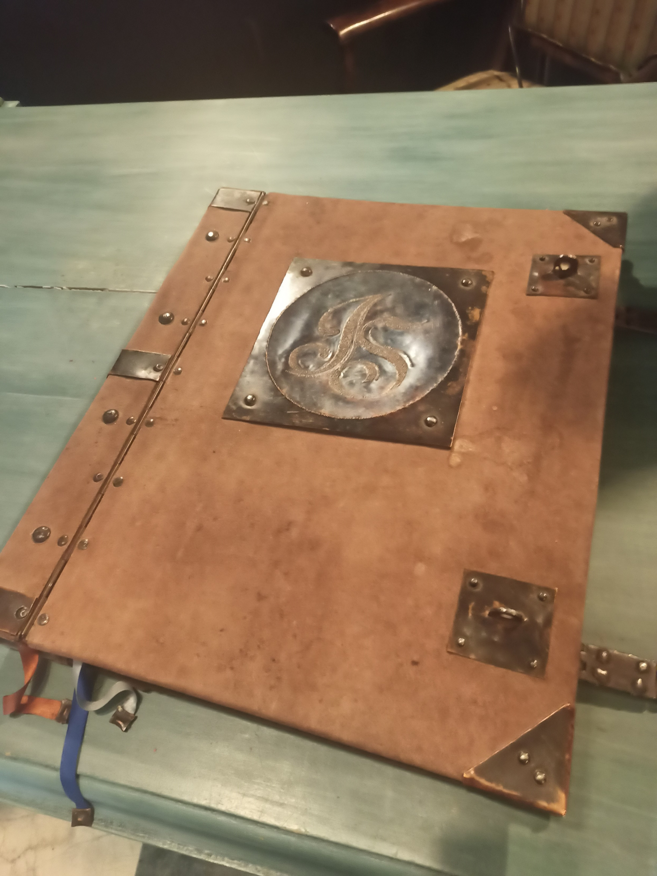


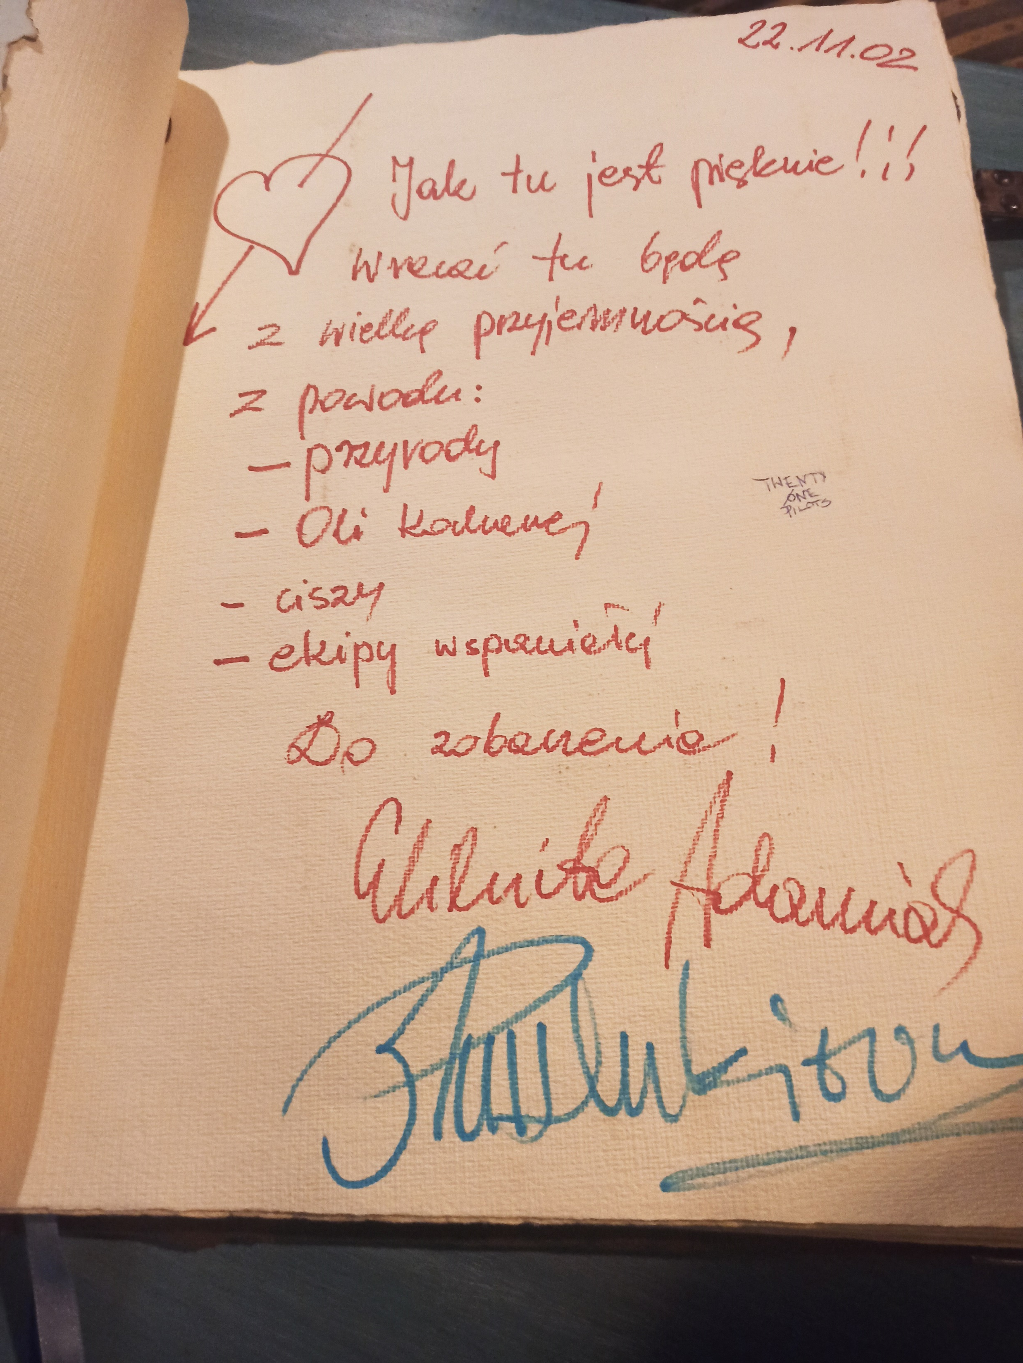
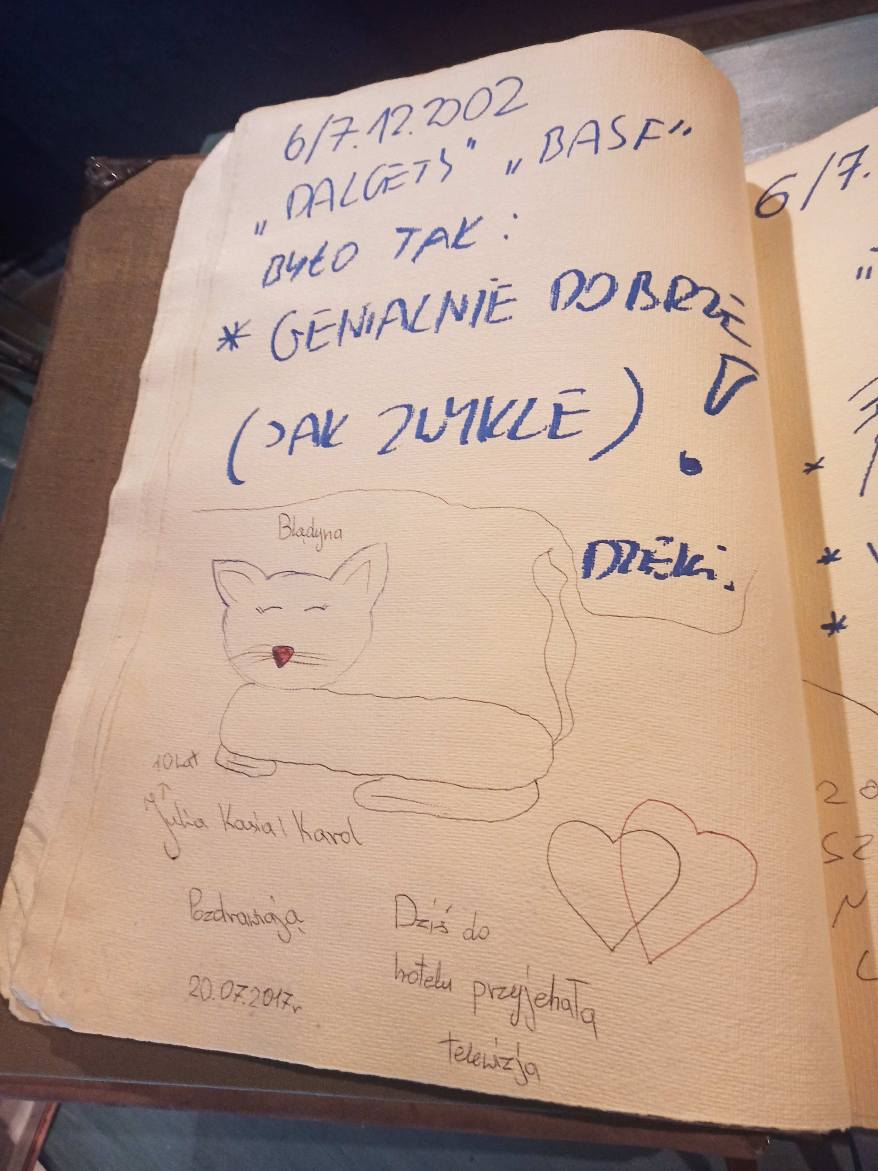
Hotel improvement based on an electronic word of mouth – a process approach
dr hab. Piotr Rogala, prof. UW; dr hab. Sławomir Wawak, prof. UK
The paper aimed to understand how electronic word of mouth is used to improve hotels. Based on information collected from seven hotels, answers were provided to the three research questions:
1. Which areas of hotel operations are influenced by eWOM?
2. Have hotels developed and implemented a systematic, process-oriented approach to processing and responding to eWOM?
3. What kind of changes are introduced in hotels based on eWOM?

Slide 3
1. Which areas of hotel operations are influenced by eWOM?
Marketing. Online reviews are extremely important for hotels, mainly because guests choose a hotel based on this rating. Low ratings significantly reduce interest in the hotel, directly leading to loss of profits. High ratings have a crucial influence on whether guests want to stay at the hotel. Additionally, positive comments can also be used to promote the hotel.
Improvement. Online reviews are also used to improve hotels. Comments indicating problems are treated by hotels as a source of information about changes that need to be introduced. Online reviews are currently the primary way to measure guest satisfaction. It is also one of the most important ways (apart from guests’ personal contact with staff) of collecting information about their needs.
Communication. Hotels constantly monitor, analyse and respond to guest reviews online. They try to respond (reply to reviews) as quickly as possible. When they receive a negative assessment, some start a dialogue with the client and try to convince him to change it.

Slide 4
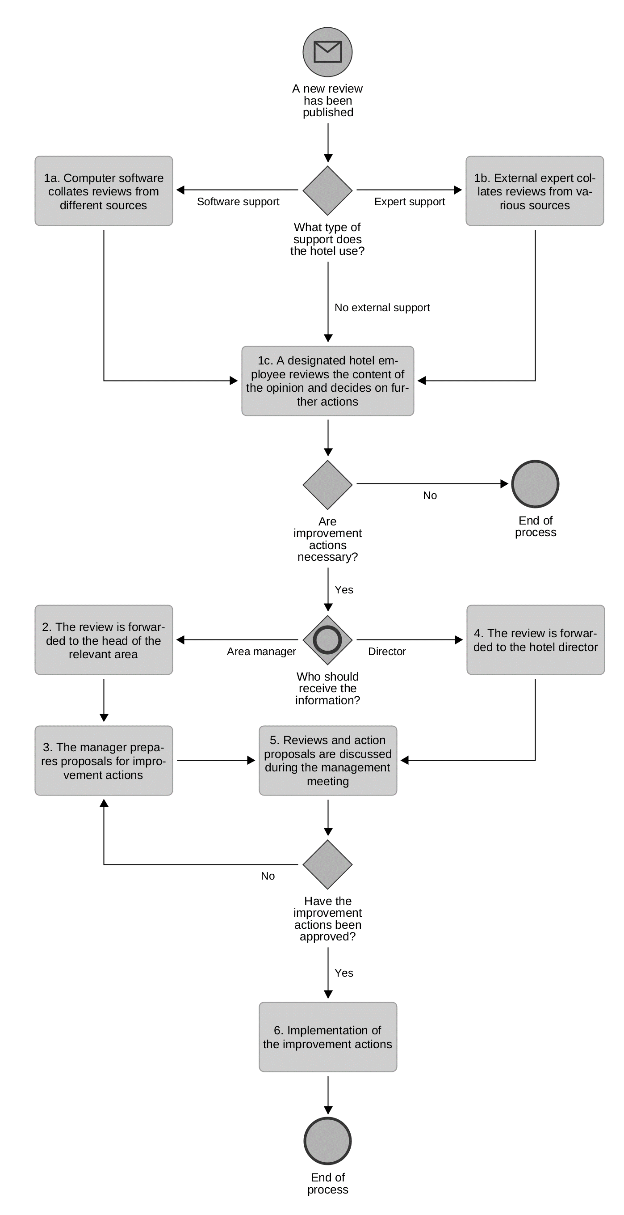
2. Have hotels developed and implemented a systematic, process-oriented approach to processing and responding to eWOM?
In each of the hotels, online reviews are used to drive improvements. However, the actions taken are of an accepted and applied practice but are not formalized in any way (e.g., not described in a documented procedure) and, therefore, not standardized.

Slide 5
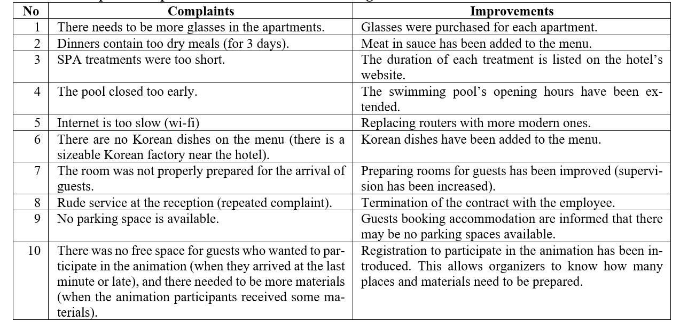
3. What kind of changes are introduced in hotels based on eWOM?
The number and importance of improvements were assessed as relatively low. Only during one interview, it was stated that the hotel had introduced significant changes within the first year of operation.
Visitor feedback covered various areas but was mainly concerned with minor technical faults and one-off incidents.

