Slide 1


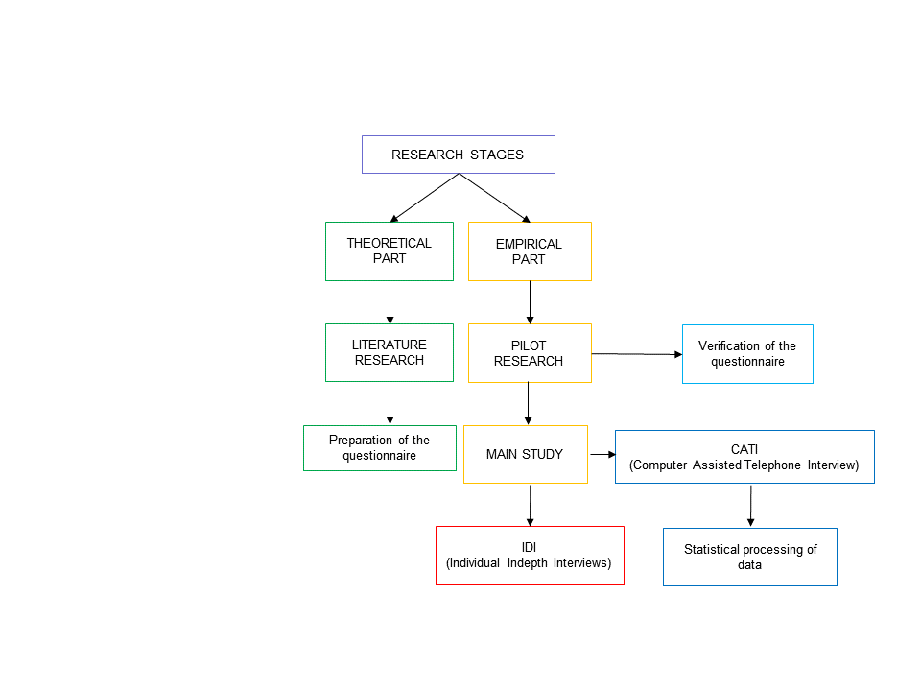
Krzysztof Wójcicki, Michał Młody, Maja Sajdak
Poznań University of Economics and Business
Miniatura 7: 2023/07/X/HS4/00223 Financed by National Science Centre
Opportunities and barriers in the digital transformation of dairy industry
AIM
RESULTS
The aim of the research was to gain knowledge about opportunities and threats resulting from the implementation of the Industry 4.0 concept on the example of organisations from the dairy industry in Poland.
How have the following areas of your business been positively affected by digital technologies? ① no positive impact ② positive impact to a narrow extent ③ positive impact ④ strong positive impact ⓪ don't know/ don't have an opinion
METHODOLOGY
CONSLUSIONS
ACKNOWLEDGMENT
Companies in the dairy sector in Poland face significant barriers in implementing Industry 4.0 technologies, mainly related to costs, infrastructure, and change management although digital technologies bring certain benefits, their impact on the key areas of business operations is currently limitedit is necessary to increase spending on modern infrastructure and seek sources of financing for Industry 4.0 technology implementations. Investing in training and staff development can address the lack of qualified personnel and resistance to change communicating the potential benefits of digital technology implementation can motivate organizations to intensify their efforts in this area.
68 enterprises took part in the study, which constitutes 13,9% of the surveyed population. Telephone interviews were conducted only with employees at selected positions within the organizations and competent to provide information on the subject matter (company owners, quality directors or managers, production directors or managers, and technologists).

