Slide 1


Slide 2
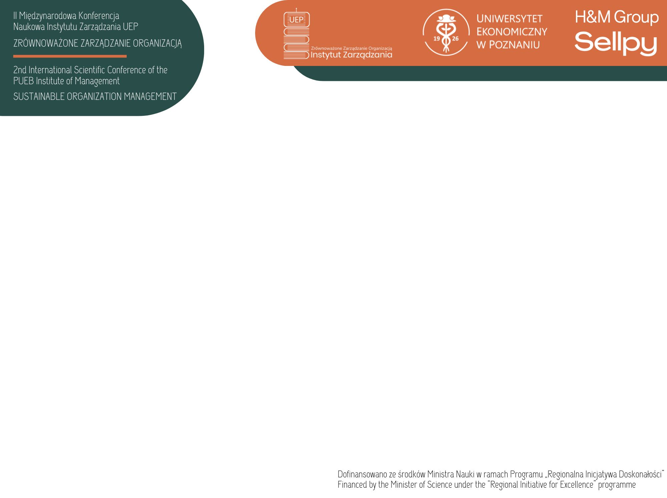
CAUSES OF CUSTOMER RETURNS IN FASHION RETAILING IN POLAND AND WAYS TO REDUCE THEM Monika ZIÓŁKO Dorota DZIEDZIC Adrian MACHATY Maciej BANIK Krakow University of Economics
With the increasing popularity of online shopping, the number of returned items in the fashion
sector is increasing. Handling returns processes
is costly for both businesses and the environment.
The aim of the
study was to
identify the
main determinants of consumer returns of purchased clothing and the factors influencing the ways of reducing them
Research method: CAWI survey on a sample of 740 people
Ways of reducing returns:
modern solutions based on AI
solutions based on AR and VR
Smart Fashion Mirrors (SFM)
virtual fitting room - allows the clothes to be properly matched to the avatar's 3D model
Result of research
Chart 1. Reasons for returning clothing products by respondents
Source: own study.

